Slide 1

Big Mountain Resort Pricing Strategy
By Ronald pacheco

Slide 2
What is the problem?
Big Mountain needs a new pricing strategy due to the newly acquired lift that will drive cost of operation up by $1.5M this upcoming season.
Scope of solution space:
By analyzing the data provided to determine which features are directly correlated to the ticket price in the ski resort market.
Criteria for success:
Implementing a model that estimates a new pricing strategy for Big Mountain according to amenities on the facility.
Determine which of the business options will yield the best results.

Slide 3
Business options
Scenario 1: Permanently close down up to 10 of the least used runs.
Scenario 2: Increase the vertical drop by adding a run to a point 150 feet lower down but requiring the installation of an additional chair lift to bring skiers back up, without additional snow making coverage.
Scenario 3: Same as above, but adding 2 acres of snow making cover.
Scenario 4: Increase the longest run by 0.2 mile to boast 3.5 miles length, requiring an additional snow making coverage of 4 acres.

Slide 4
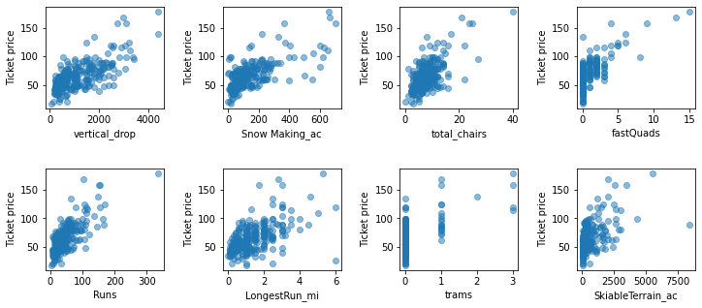
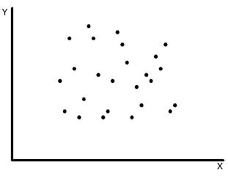
Key findings
There is no strong correlation between ticket price and the state the resort is in.
Features that drive the ticket price are vertical drop, snow making area, total number of chairs, number of fast quads, runs, longest run, trams, and skiable terrain area.
Predicted price is $95.87 (+- $10.39) .
NO CORRELATION
Price
State

Slide 5
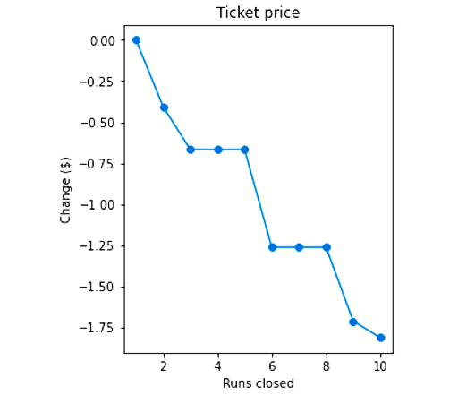

Recommendations
A combination of Scenarios 1 & 2 may have better results: 5 least used runs are closed, and a 6th one is modified to increase vertical drop by 150 feet.
A price increase of $4 to $24.

Slide 6
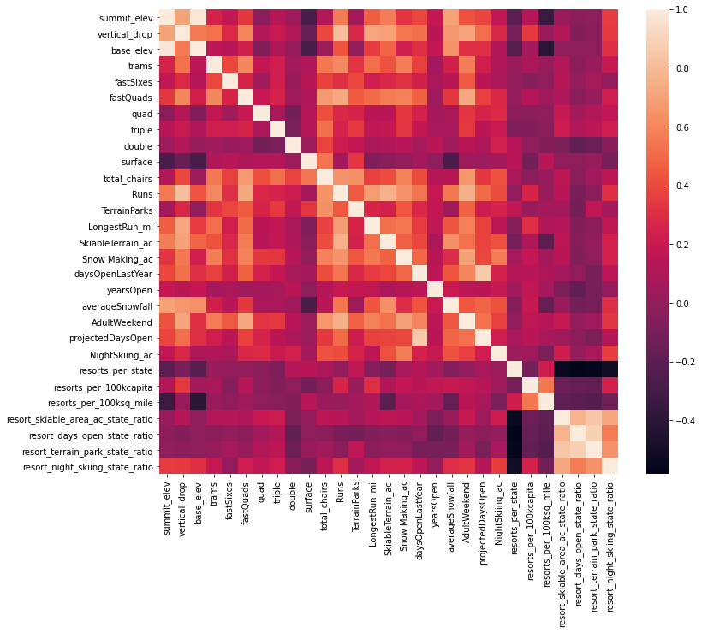
MODELING AND RESULTS ANALYSIS
The correlation heatmap showed positive correlation between ticket price and vertical drop, snow making area, total number of chairs, number of fast quads, runs, longest run, trams, and skiable terrain area.

Slide 7
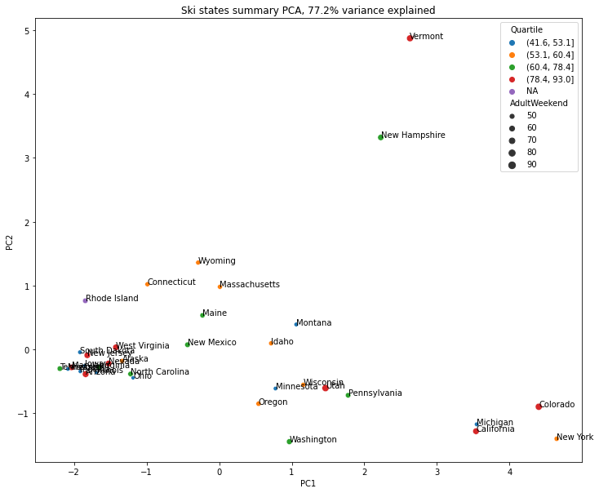
MODELING AND RESULTS ANALYSIS
An analysis of state area and population reveal no defined tendencies.
Bigger or more populated states did not necessarily have higher ticket prices.
PCA did not reveal a clear grouping.

Slide 8
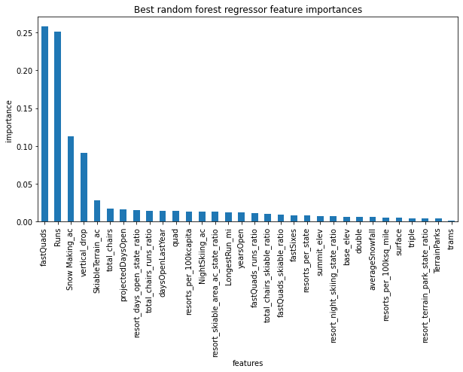
MODELING AND RESULTS ANALYSIS
Random Forest was the best model, with an average cross-validation error of $9.5.
Pipeline values:
Pipeline(steps=[('simpleimputer', SimpleImputer(strategy='median')), ('standardscaler', None), ('randomforestregressor', RandomForestRegressor(n_estimators=69, random_state=47))])
Dominant features:
fastQuads
Runs
Snow Making_ac
Vertical_drop

Slide 9
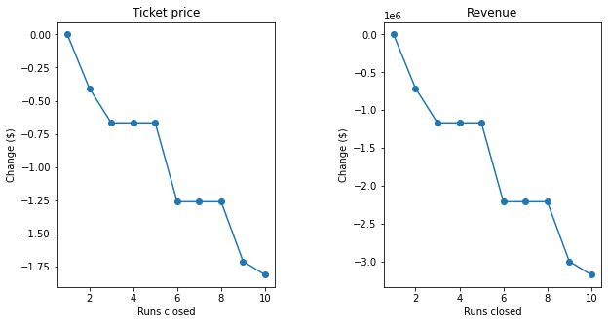
MODELING AND RESULTS ANALYSIS
Scenario 1 Analysis
Closing 3 to 5 runs will have the same impact on ticket price. Therefore, closing 5 runs will lead to more savings.
Closing 6 to 8 runs will have the same impact on ticket price, however, the ticket price will be affected around double compared to closing 3 to 5 runs.
Scenario 2 Analysis
This scenario increases support for ticket price by $1.99. Over the season, this could be expected to amount to $3,474,638.
Scenario 3 Analysis
This scenario increases support for ticket price by $1.99. Over the season, this could be expected to amount to $3,474,638.
Scenario 4 Analysis
This scenario makes no difference whatsoever for ticket price, yielding no revenues.

Slide 10
SUMMARY AND CONCLUSIONS
Big Mountain is amongst the top tier resorts of the country, having more relevant features than the average for the country.
Big Mountain is underselling their value by around $14/ticket.
In the future, focusing on improvements of vertical drop, snow making area, total number of chairs, number of fast quads, runs, longest run, trams, or skiable terrain area will yield a higher ROI.
Skiing resort prices are set by a free market dictated by the demand of the features mentioned above.

Slide 11
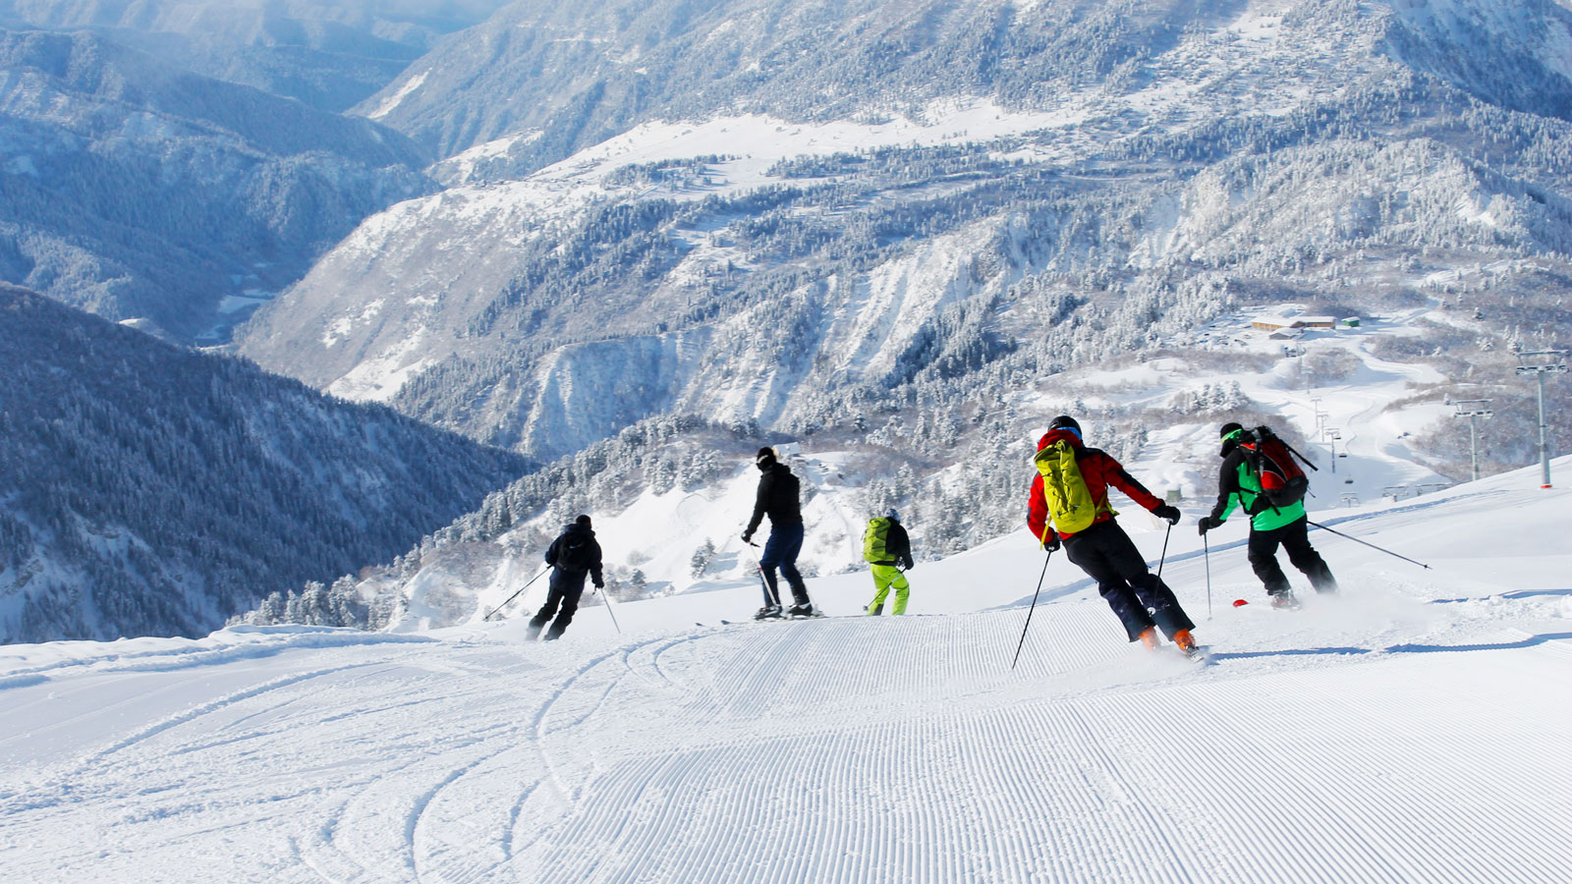
Thank you

